Slide 1
Creating a custom brush tool
Use this so that you can create your specific shaped selections into a saved shape which you can use as a brush.

Slide 2
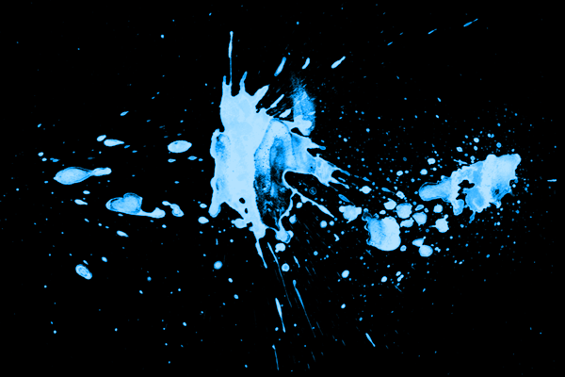
1. Open Photoshop and open the image you want to create your brush from. I am using this image, which you can either copy from here or from the below link (this will be better quality).
http://photoshoptutorials.ws/images/stories/DriedBloodSplattersPhotoshopBrushes_F902/image_11.png

Slide 3
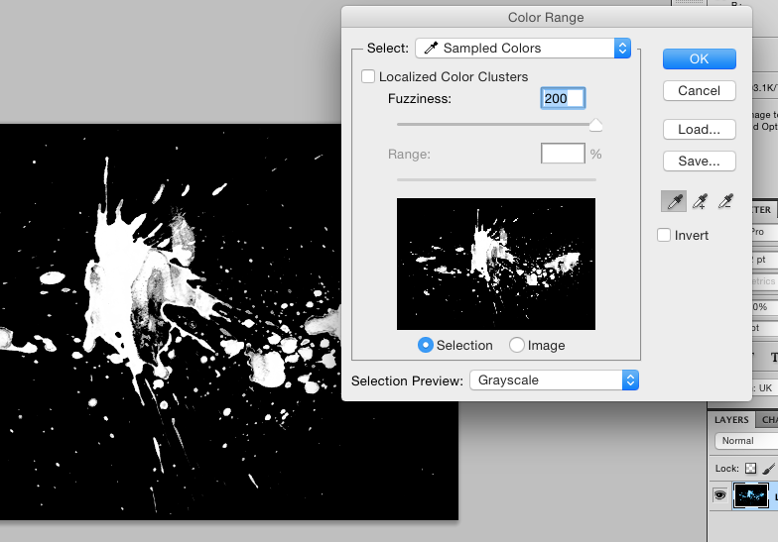
2. Go to “Select” on the top menu bar, and click on “Colour Range”. This will open the below box. On your actual image, click anywhere on the shape you want to select. I clicked in the middle of the big blue blob. The adjust the sliders so that in the black and white image, you can see the shape you want to create in white.
Click here on your image to tell the program what colour you want to select.

Slide 4
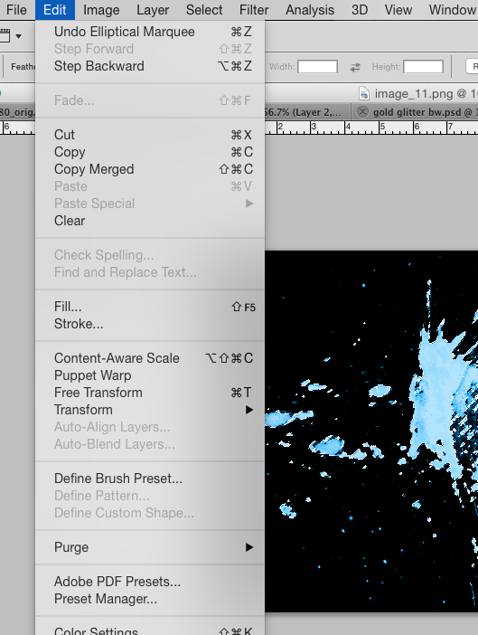
3. Once happy with your selection, go to “Edit”, then “Define Brush Preset”.
Name your brush shape a name you will recognise and remember.

Slide 5
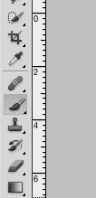
4. You have now saved your selection shape as a brush in your brush menu. You can now choose this and use it whenever you need to use a brush. I have used it to delete part of this gold layer, building on from the previous tutorial.

Slide 6
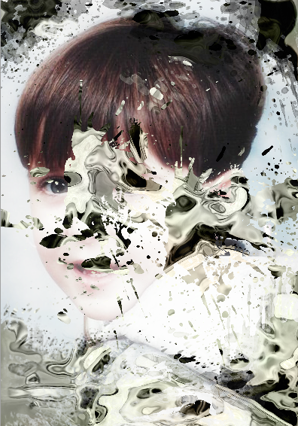
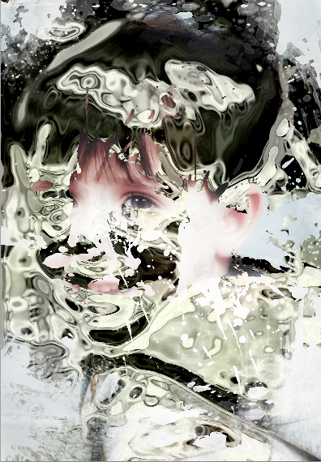
Here are 2 versions of my deleted gold layer, making it into a mask layer and then using my custom brush shape to delete parts of it by painting with black.

