Slide 1
Daniel Crooks
What do you think the artist is trying to explore in this work?
How does it link to your “movement” work?
Notes:
http://vimeo.com/77654682

Slide 2
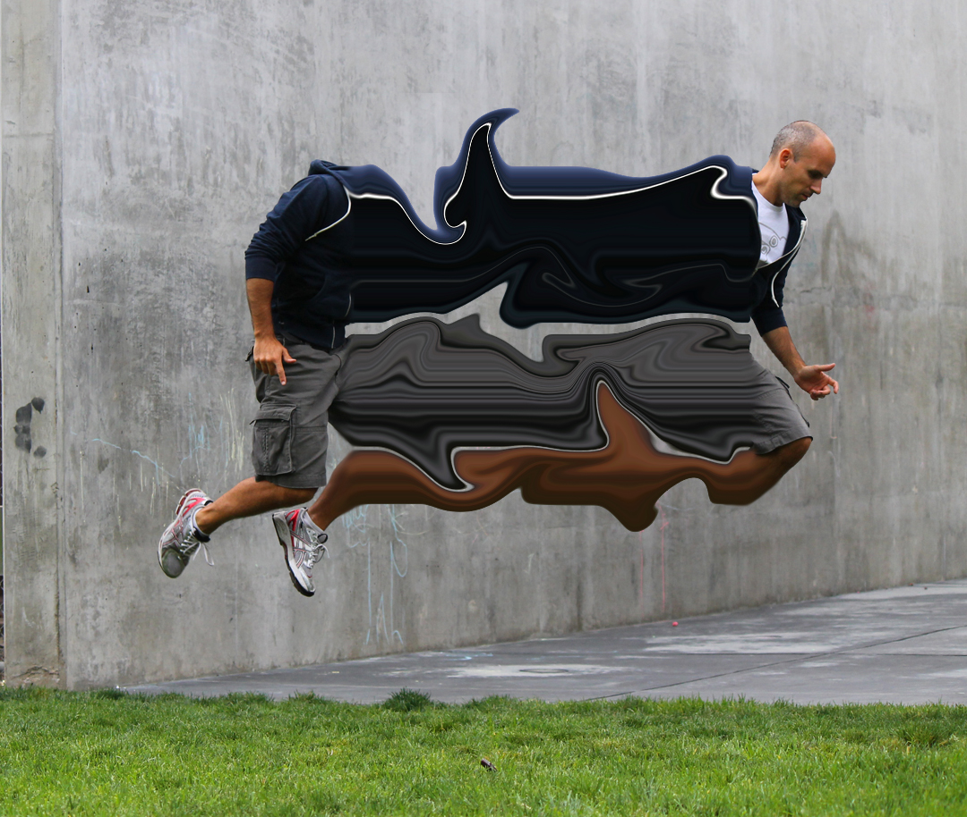

Slide 3
Go to youtube and type in: “Photoshop CC14 Liquify Tutorial”
Rectangular Marquee Tool - use this to select with
Move tool
Quick selection tool – use this to select your figure
Single Column Marquee Tool - use this to select the pixels you will stretch out
Clone Stamp Tool – use this to cover over parts of your original image
Smudge tool – use this to blend the edges of your layers
REMEMBER!!!
Check the settings of your tools are the same as in the video
Notes:
https://www.youtube.com/watch?v=PifRTVqN1dk

Slide 4
The stages you will work in …
Open image in Photoshop
Use Quick Selection Tool to select figure
Make this a new layer by going to Layer – New – Layer via Copy
Use Single Column Marquee Tool to select a row down the middle of your figure and repeat step 3.
Go to Edit – Free Transform and stretch out this row. Click tick when done.
TRICKY PART – click onto the layer with your figure, use the Rectangular Marquee Tool and select the part of your figure that sits behind your stretched layer. Then do Layer – New – Layer via Cut.
Move this new layer into position.
Click your stretched layer. Go to Filter – Liquify. Use the settings to create movement. Click ok when done.
Click the background layer. Use the Clone Stamp Tool to paint over parts of your original image.
Click the stretched layer. Use Smudge Tool to smooth the edge on your stretched layer into those behind it.

Slide 5
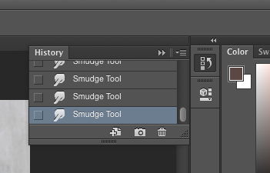
If you get stuck or make a mistake …
Use the video to help you. Pause it as you work along with it. DO NOT WATCH IT ALL AT ONCE!
If you make a mistake …
Click on History and go back as far as you need to.

