Slide 1
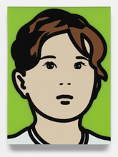
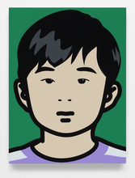
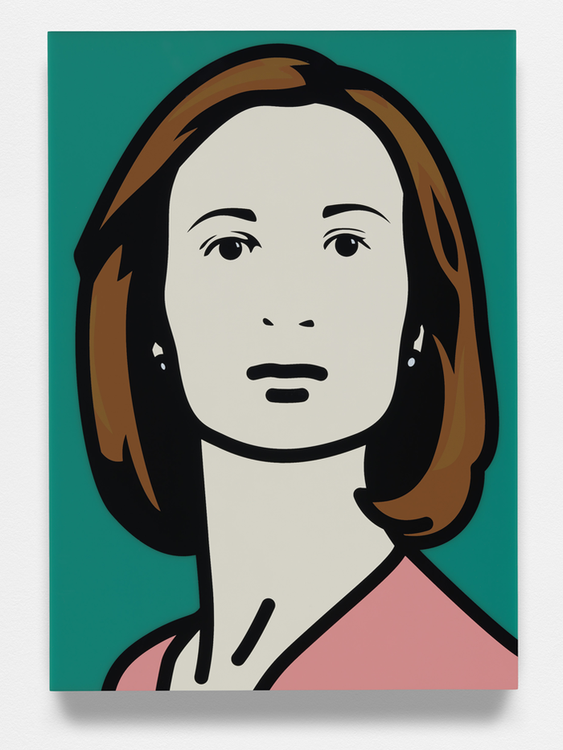
How to covert photos into the style of Julian Opie

Slide 2
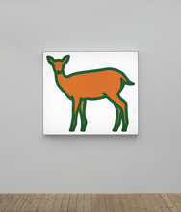
Who is Julian Opie
https://www.julianopie.com/
Julian Opie is a contemporary British artist known for his distinctive depictions of figures, portraits, and landscapes. The highly stylized treatment Opie gives his subjects—whereby features are created by thick black outlines and filled in with solid areas of flat colour—is a blend of Pop Art and Minimalism with a wholly contemporary sensibility.
“The process of reading things as simulations but knowing at the same time that they are real is quite central to my work,” Opie has observed of his own art. Born in 1958 in London, United Kingdom, Opie studied with Michael-Craig Martin at Goldsmiths in London during the early 1980s. His earliest works consisted of painted steel sculptures exploring the relationship between visual and spatial observation.
He is part of the group know as New British Sculpture, alongside artists such as Anish Kapoor and Tony Cragg. Over time, the artist has expanded his practice to include painting, installation, and cover art for albums. The artist’s works are part of the collections of The Museum of Modern Art in New York, the National Portrait Gallery in London, the Stedelijk Museum in Amsterdam, and others.
Opie currently lives and works in his hometown of London, United Kingdom.

Slide 3
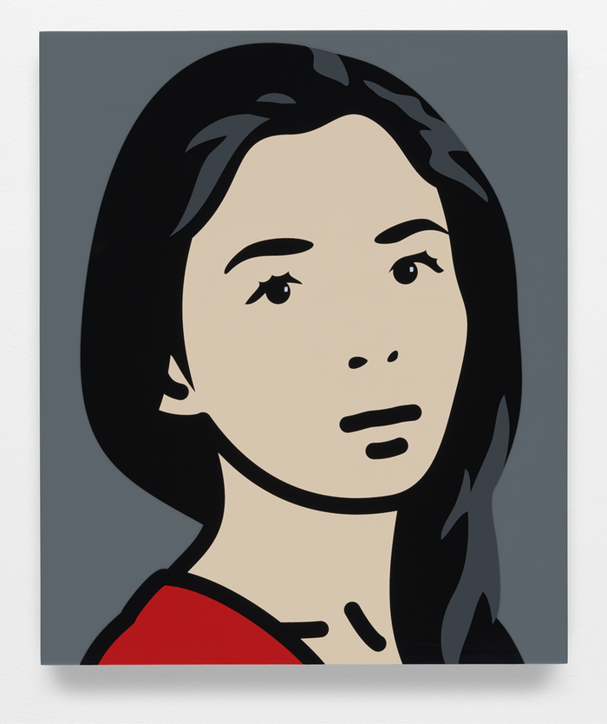
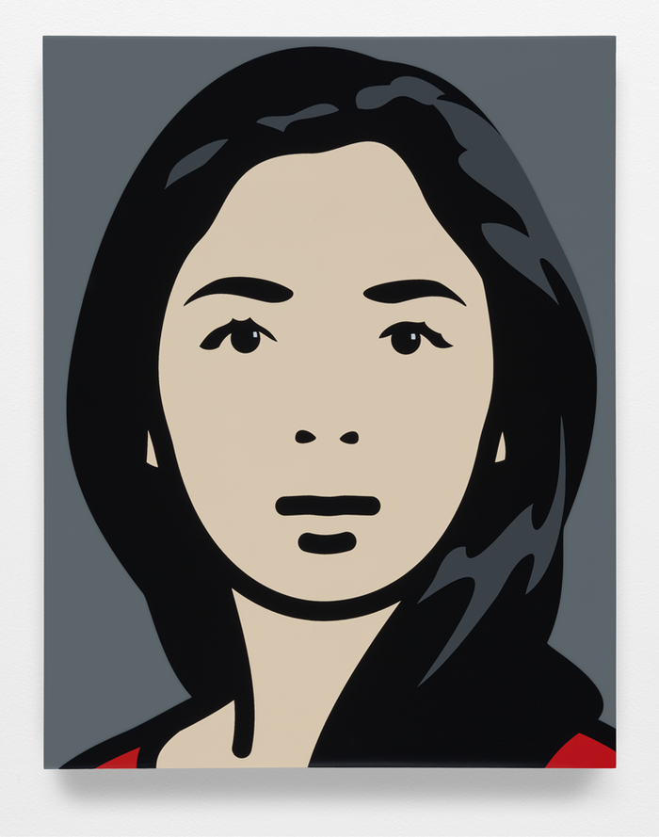
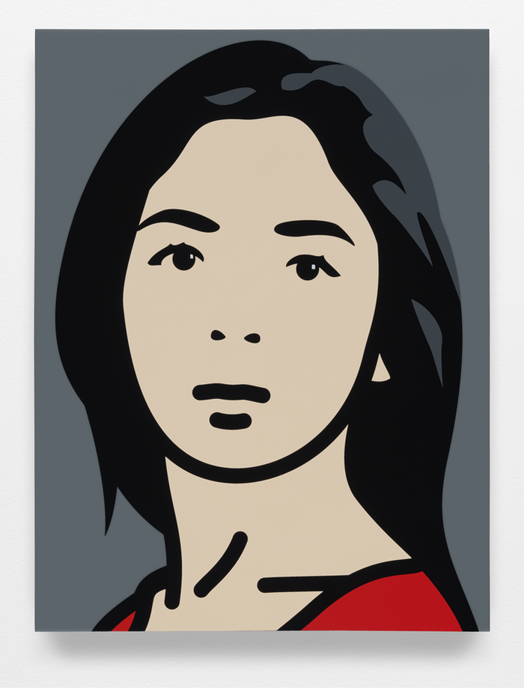

Slide 4
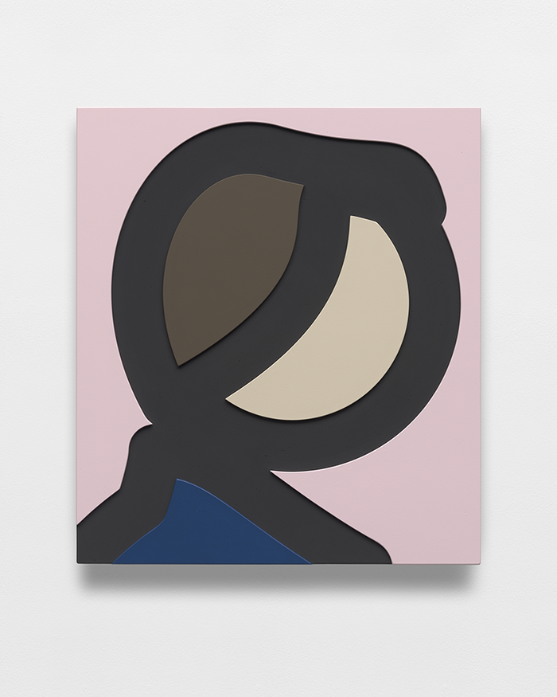
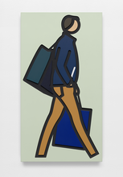
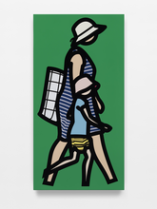
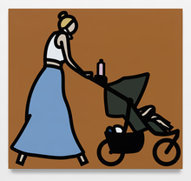
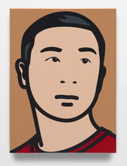
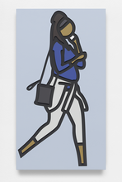
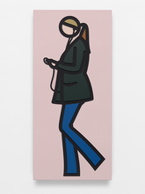
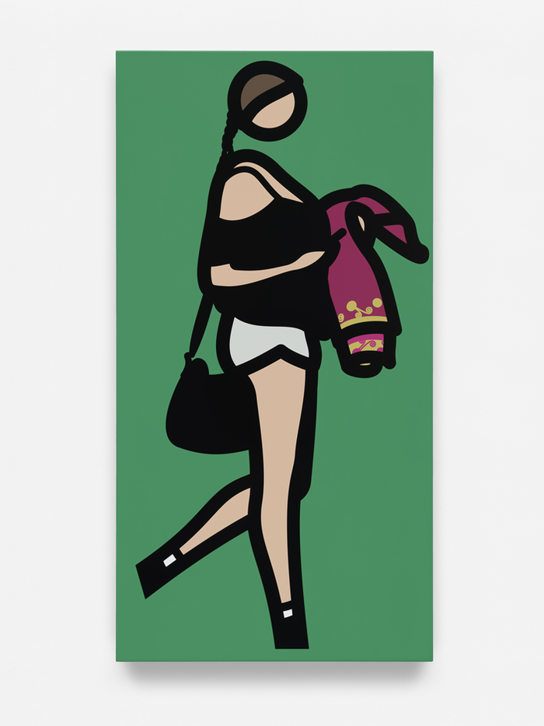
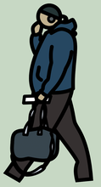

Slide 5
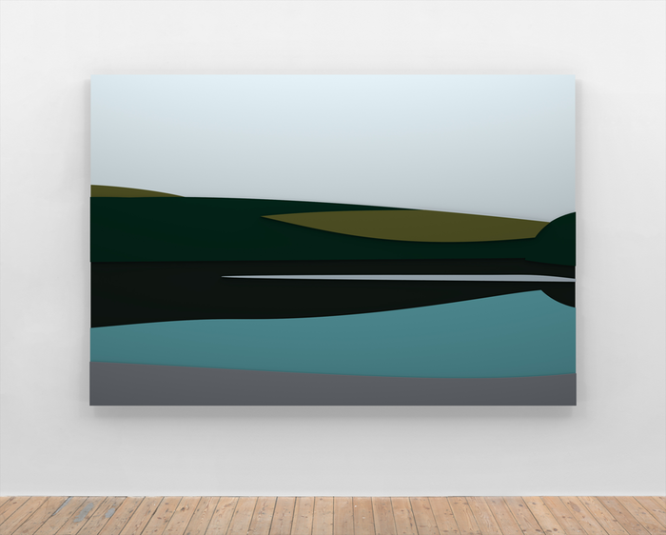
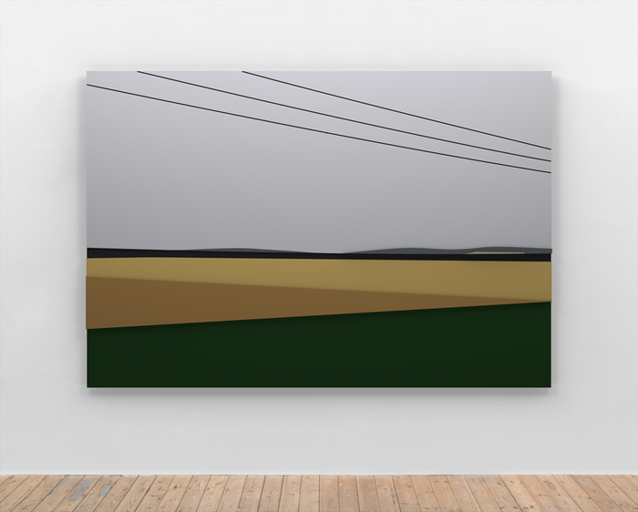

Slide 6
How to convert your image tutorial
You can convert any image, or subject matter, into a Julian Opie style picture. It doesn’t have to be a portrait.
Try a few images with differing subject matter.
This tutorial instruction in Photopea, which is a free online photo editing program similar to Photoshop. You will find it very similar in use, style and layout to Photoshop.
https://www.youtube.com/watch?v=fblccGITrt0

Slide 7
Submitting your finished work
Please save your images to:
Your Weebly page
Our Teams Gallery in collaboration space
Thank you!
I hope you enjoyed this tutorial.
Ms Brem.

