Slide 1
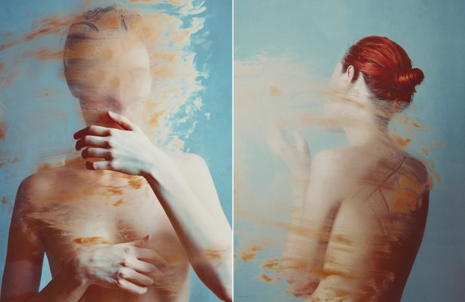
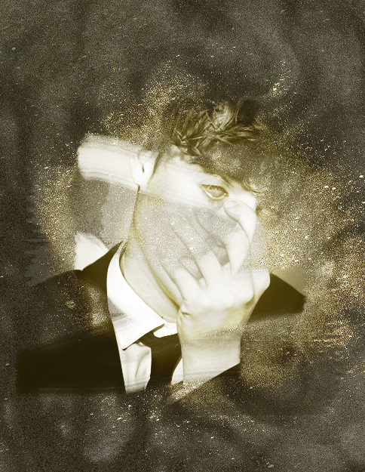
How to create a layered image that appears to reveal itself from under a textured surface
Flora Borsi
A practical response

Slide 2
1. Open the image you want to reveal and your texture / surface image in photoshop – you can either take your own surface image or find one from the internet. I searched “gold paint”
2. Using the “move tool”, click on your texture image and drag and drop it on top of your subject image.

Slide 3
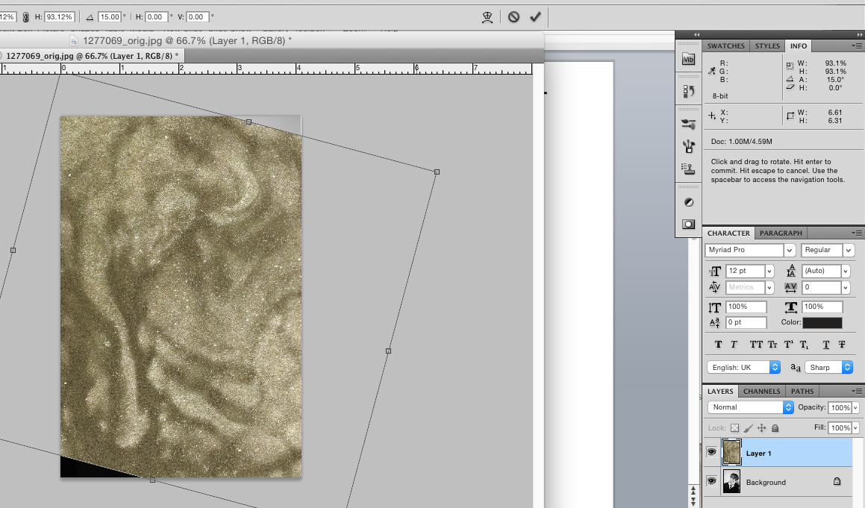
3. Position your surface texture how you would like it, then click on the tick icon in the top right. Crop it down to get rid of any unwanted corners. Take the opacity down so that you can view the image underneath.

Slide 4
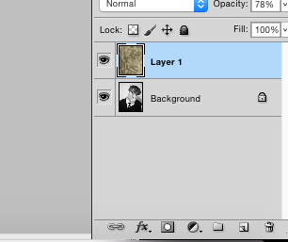
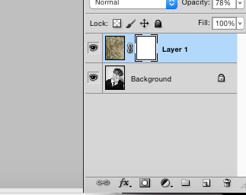
4. Add a layer mask onto your surface (top) layer by clicking on this icon. This means you can constantly change what you see and don’t by painting with either black or white.

Slide 5
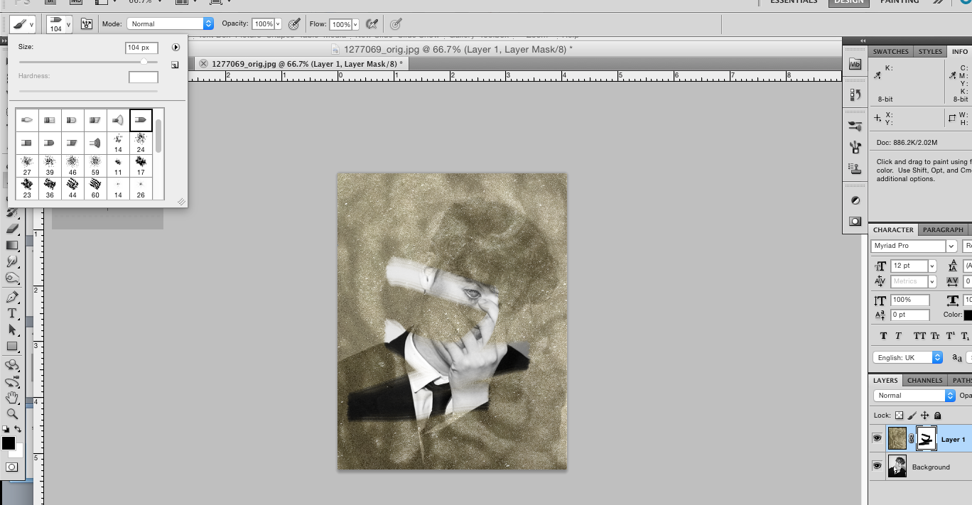
5. Click on the brush tool and then click on the brush menu in the top left corner. Select a brush type that roughly matches the texture you are trying to create. I have chosen a paint brush shape as my texture is wet paint. Making sure you have black selected in your palette, and that you are clicked onto your “mask” layer, paint over the area of your texture you wish to hide. This will reveal your image underneath. Remember, if you make a mistake you can either go back, or swap your palette to white to paint it back in!

Slide 6
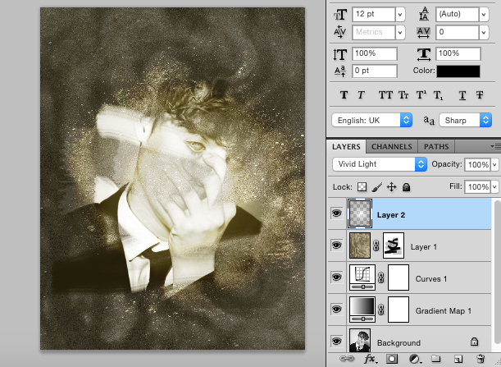
6. Turn the opacity of your texture layer back up to 100% and make any necessary adjustments.
7. Using the adjustment mask layers, edit the tones and contrast of both images until you are happy with the combination. Here, I have increased the contrast of the portrait so that it stands out from the paint, and added a gradient layer over the top of all layers to create a spotlight effect.
Gradient map (changes colour or the tones) and curves mask to portrait, positioned underneath the texture layer!
Created a new layer on the very top, used the gradient tool to create a spotlight, set the blending mode to “vivid light”

Slide 7
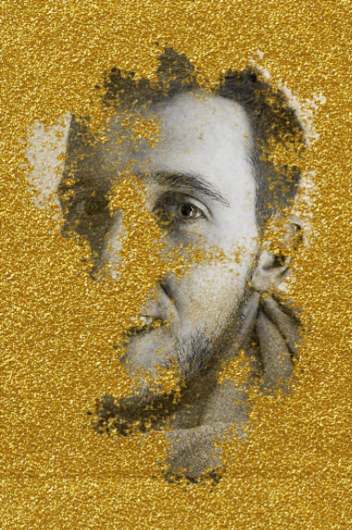
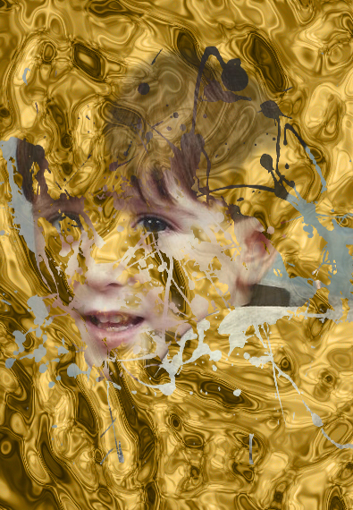
What to do next …
Experiment with different textures and brush techniques. I have included some additional examples.
You can create your own brush shape by following the additional tutorial:

