Slide 1
Graphic Designer Digital Artist Magdiel Lopez

Slide 2
Magdiel Lopez
Born in Havana Cuba, Magdiel Lopez was 15 when he moved to the US. Lopez self-trained as a designer. His work is inspired by growing up surrounded by colourful Cuban culture.
Magdiel created a series called “A Poster A Day” — releasing one piece of artwork on his Instagram everyday for 365 days. Which ultimately lead his work to be featured in the New York Times, Cosmopolitan, Entrepreneur, and Awwwards.
Magdiel lives in Dallas Texas where he runs his own creative agency, Belmont Creative. Belmont Creative.
Born in Havana Cuba, Magdiel Lopez spent his childhood years inspired by the colorful culture that surrounded him. Naturally, such upbringing played an integral part in forming Lopez’s keen sense of style, art and design, which can be realized in his works today. Looking for freedom and a better life, Lopez moved to the United States at fifteen, where he continued working on his skill for the next 10 years privately. Magdiel decided to reveal his work in a series called “A Poster A Day” — releasing one piece of artwork on his Instagram everyday for 365 days. Each day garnered more attention from a global audience, ultimately leading Magdiel to be featured by the New York Times, Cosmopolitan, Entrepreneur, and Awwwards. To date, Magdiel has worked with several brands such as Apple, Nike, Absolute Vodka, MTV, Warner Brothers, etc., and currently has a partnership with Adobe as a design mentor and creative. Magdiel lives in Dallas Texas where he runs his own creative agency, Belmont Creative. Belmont Creative.

Slide 3
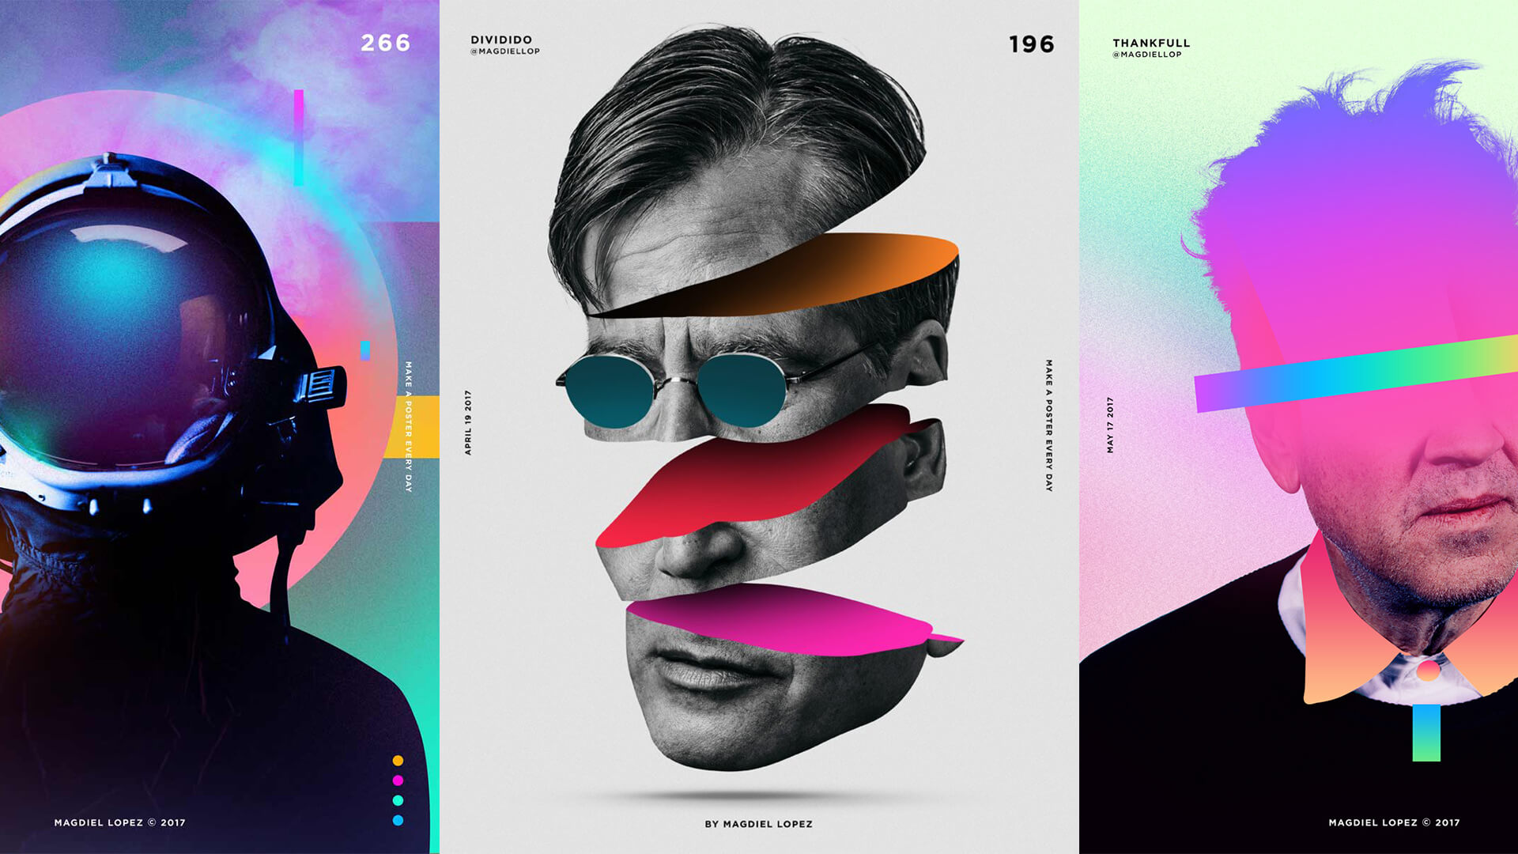

Slide 4
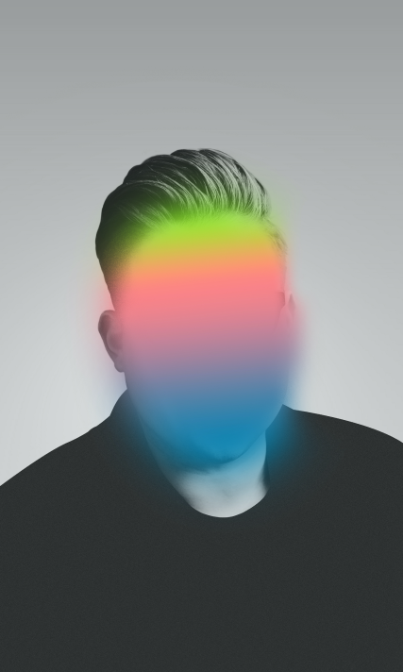
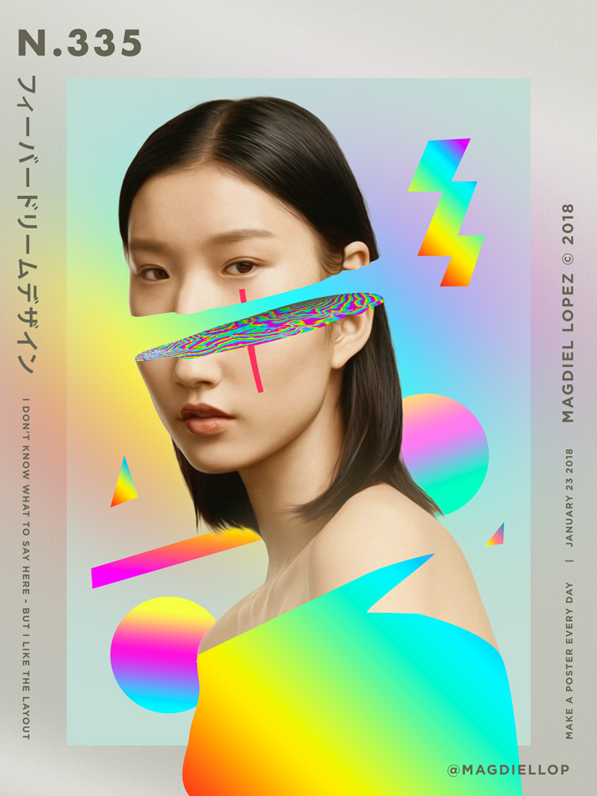

Slide 5
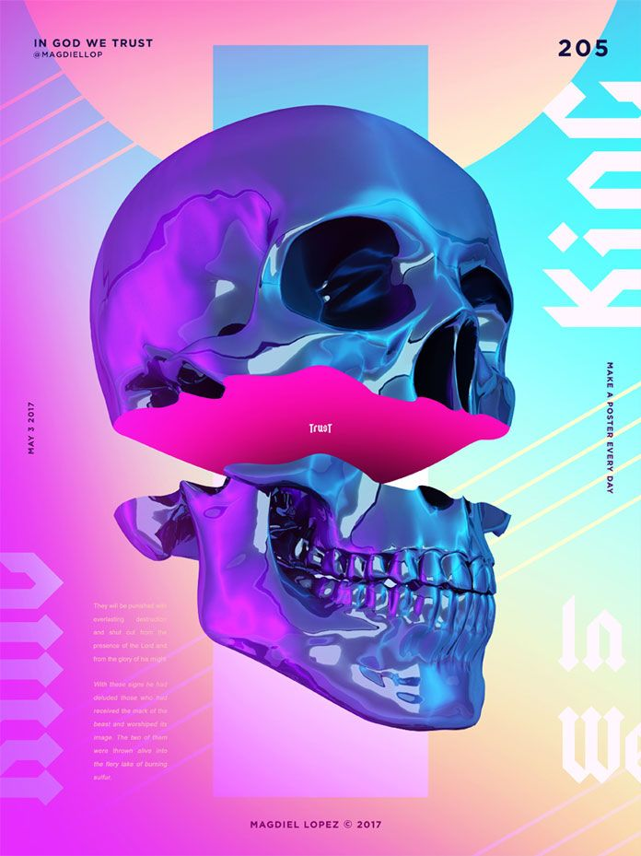
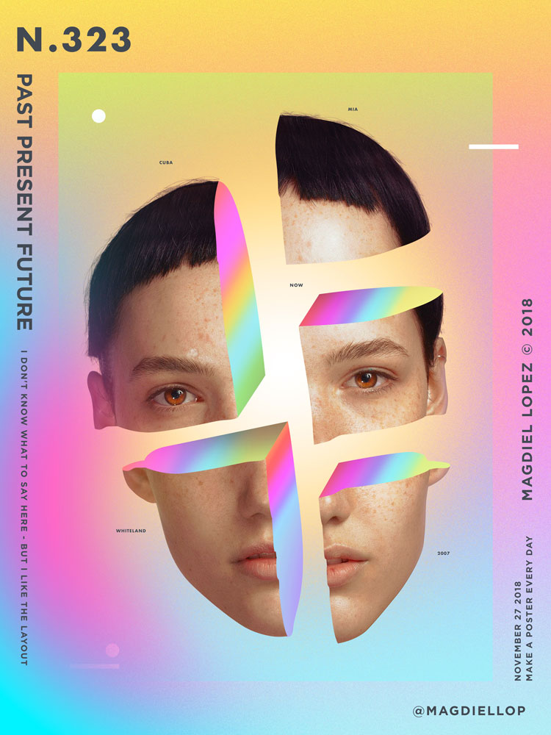

Slide 6
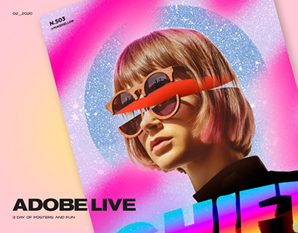

Slide 7
How to make a sliced portrait in the style of Magdiel Lopez
You will need an image to manipulate. (You can use the picture on the next slide if you don’t have one. Or find a copyright-free image here: https://www.pexels.com/
I recommend you take hand written notes. This will help you remember, record and allow you to refer back to later.
Consider your colour scheme and how the final image will look.

Slide 8
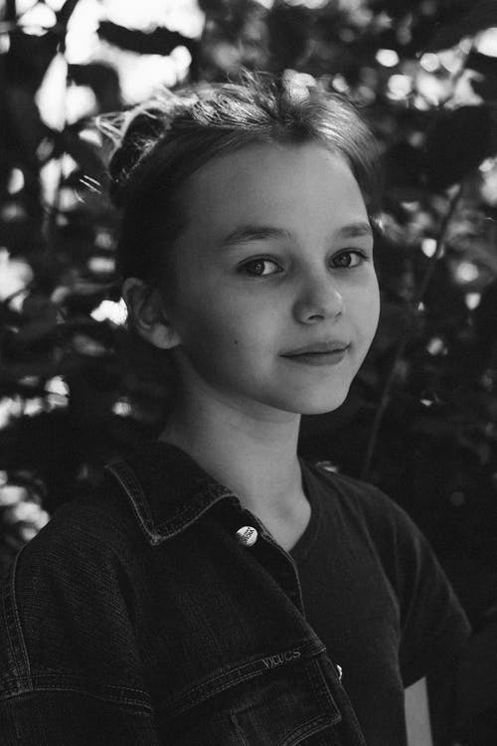
Like all things in Photoshop there are several different ways to achieve the exact same result.
Watch both videos to help you decide which method you prefer to use.
This one uses an alternative to Photoshop called Photopea.com
https://www.youtube.com/watch?v=VyVHZq28k3A
This links shows you a different way to get the exact same effect: https://www.youtube.com/watch?v=DPSs1IxiDsM

Slide 9
Save a copy of your finished artwork to these places:
Your weebly
In Teams Class Notebook to our Gallery Page in the Collaboration Space folder
And also in Teams Notebook to your own named folder.
During this tutorial you used the
following tools:
Selections
Layers
Masks
Transform
I look forward to seeing your finished artworks done in the style of Magdiel Lopez.
Ms Brem.

