Slide 1
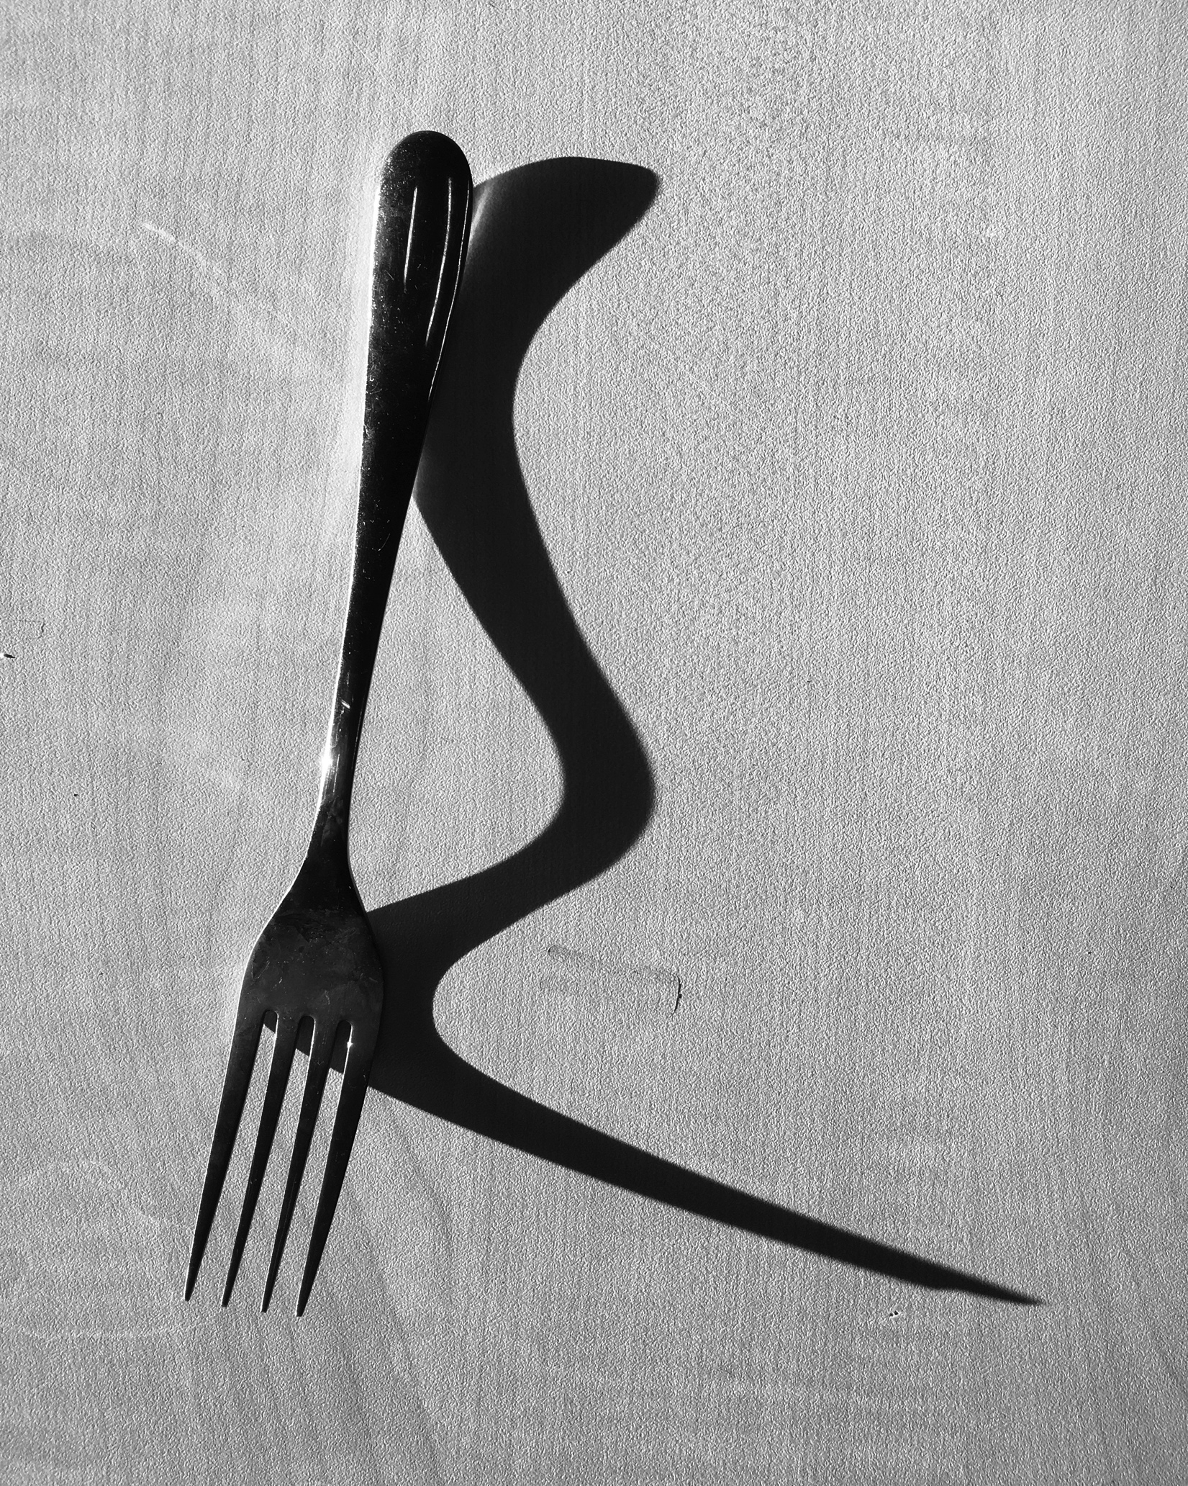
Annotating your own photographs |  | Example…
What did you do? | What is the idea behind your photograph? What is it showing? What is the photograph about? How is it personal to you? This photograph shows… | This photograph shows an everyday object (a fork), taken in the dramatic style of Edward Weston. I have formed a shadow from the object, which within the composition has created a second shape entirely. My work is about how there are many different perspectives to consider when viewing a situation and how it is sometimes not how it seems on the surface. I have a large family and there are often various points of view regarding a situation, therefore I need to remind myself of the importance of considering everyone’s opinions.
Why did you do it? | How does your artwork explore the main theme? How did your artist/s inspire your work? My idea explores the theme…because… …(artist)….inspired me to…. | My idea links to the given theme ‘ordinary and/or extraordinary’ as I have taken an everyday, ordinary object and transformed it, into an extraordinary sculpture. To achieve this, I have mimicked the high contrast lighting, cropped composition and shadow forms found in Edward Weston’s photographs. Edward Weston has inspired me to consider the beauty of ‘ordinary’ objects we interact with everyday, highlighting their sculptural forms and presence.

Slide 2
Annotating your own artwork |  | Example…
How did you do/make it? | Explain how you created your artwork (what were the steps you took to create the photograph in the way you did? I used … lighting to …. On photoshop, I… | I used strong side lighting to allow me to create a second shape (formed by a shadow) within my composition. I transformed the image into a monochromatic (black and white) photograph in order to heighten the focus on the object and shadow, as I felt the inclusion of colour may distract the viewer from the key forms within the image. I was also careful not to include any unnecessary elements within the photograph (such as other objects), especially in the background as this could have effected the dominance of the object within the photograph, distracting the viewer’s focus.
Assess quality | How successful have you been? What are you pleased with? What could you improve? I am pleased with the way I… | I am pleased with the way I managed to successfully portray (show) an ordinary object as extraordinary through lighting and composition. However, I think it could possibly be improved by changing the background to completely plain, as a feel some of the grains within the wood distract the viewer’s attention from the object.
Moving forward | What did you learn? What did you find out? What are your next steps? On the next page/s I will…. (explain why this will improve your artwork/idea) | During the taking and editing process of making this photograph, I have learnt the importance of composition, ensuring all elements that are not relevant to my message are removed. On the next stage, I will experiment with other cropping techniques in order to explore my idea and links to the theme ordinary and/or extraordinary in more depth, pushing how our perception of the ordinary can be altered (changed).

