Slide 1
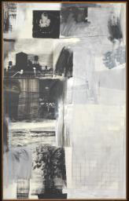
Robert Rauschenberg
American painter, sculptor, printmaker, photographer and performance artist. While too much of an individualist ever to be fully a part of any movement, he acted as an important bridge between Abstract Expressionism and Pop art and can be credited as one of the major influences in the return to favour of representational art in the USA. As iconoclastic in his invention of new techniques as in his wide-ranging iconography of modern life, he suggested new possibilities that continued to be exploited by younger artists throughout the latter decades of the 20th century.
Almanac 1962

Slide 2
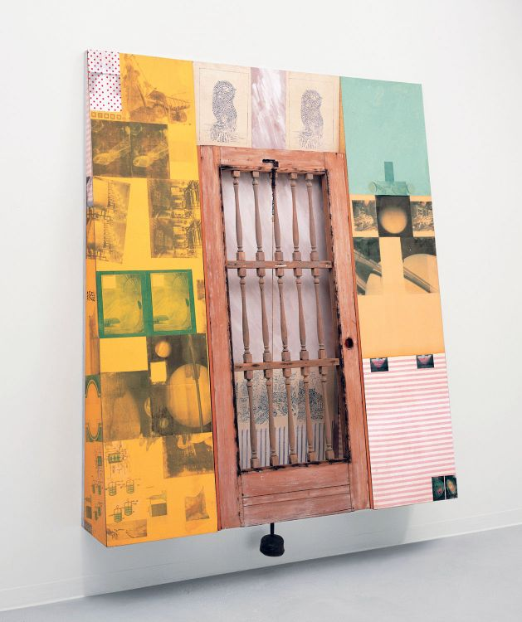
Photography’s Abstraction
In Camera Lucida, Roland Barthes insists, “A specific photograph, in effect, is never distinguished from its referent (from what it represents), or at least it is not immediately or generally distinguished from its referent.”¹⁸ Barthes asks his audience to take into account the processes of framing, lighting, exposure, printing, and cropping, emphasizing that even the most straightforward photograph is always an abstraction of reality. Rauschenberg considered the process to be even more direct. “What you see in front of you is a fact,” he commented. “You click when you believe it’s the truth.” He went on to note that “information is waiting to become in essence a concentration . . . [that] can be projected back into real life, into your recognition.”¹⁹Despite his inclination to evoke a strenuously reliable image of reality, albeit highly condensed, Rauschenberg’s photographic truth lent itself to abstraction through the processes of transference, recontextualization, juxtaposition, and fragmentation, and his insistence to actively involve viewers in the creation of a work’s meaning.
Notes:
CAT. 82 Robert Rauschenberg (1925–2008), Solar Elephant (Kabal American Zephyr), 1982. Solvent transfer, fabric collage, acrylic, wood door, wood mallet, metal spring, and string on wood support; 104 x 83 x 15 3/4 inches (264.2 x 210.8 x 40 cm). Robert Rauschenberg Foundation, New York, New York. © Robert Rauschenberg Foundation / Licensed by VAGA, New York, New York.

Slide 3
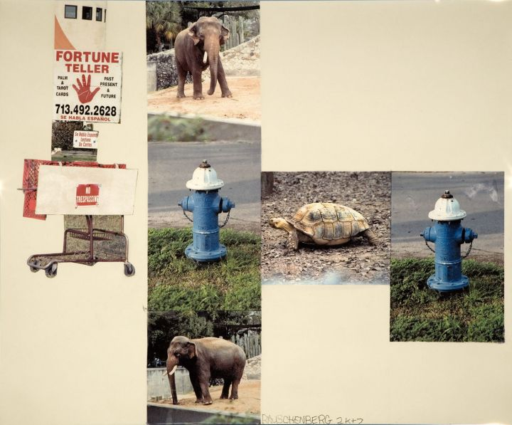
Rauschenberg brings together photographs of elephants, an image of a turtle, fortune telling signs, a no trespassing sign, and photographs of a blue fire hydrant. Laurence Getford, Rauschenberg’s former studio assistant, noted that when Rauschenberg was unable to move about freely in his later years, he dispatched his assistants with cameras, instructing them to take photographs of “uninteresting things,” emphasizing his belief that “the unimportant was as important as the important.”
Robert Rauschenberg (1925–2008), Meditative March (Runt), 2007. Inkjet pigment transfer on polylaminate, 61 x 73 1/2 (154.9 x 186.7 cm).

Slide 4
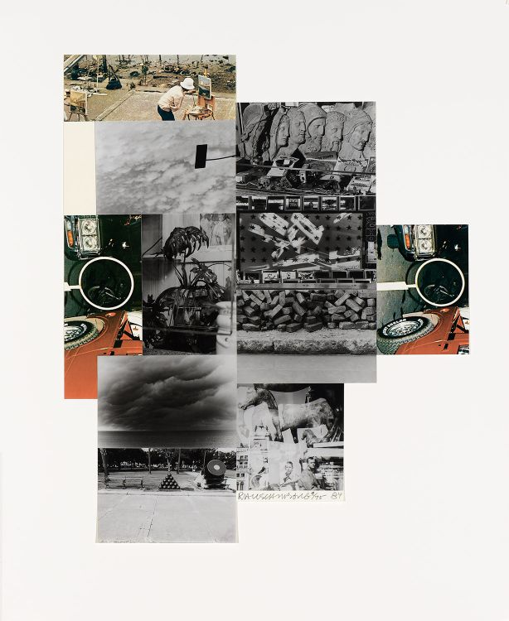
Robert Rauschenberg (1925–2008), Untitled, 1984. Screenprint with fabric and photo collage on hand-cut paper, edition 9/75, 31 7/8 x 26 3/8 inches (81 x 67 cm). Collection of the Nasher Museum of Art at Duke University, Durham, North Carolina. Gift of Blake Byrne (T’57), Susan and David Gersh, Bea Gersh, and Carol and David Appel; 2006.9.1. © Robert Rauschenberg Foundation / Licensed by VAGA, New York, New York. Photo by Peter Paul Geoffrion.

Slide 5
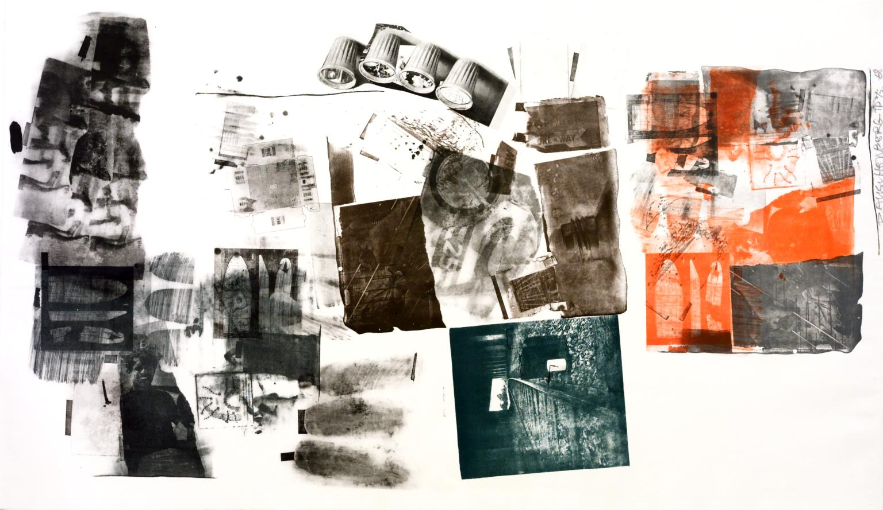
Water Stop 1968

Slide 6
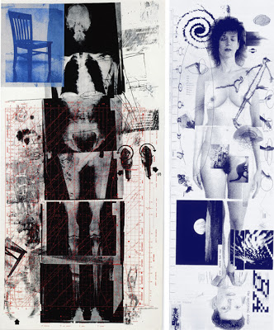
Booster, 1967

Slide 7
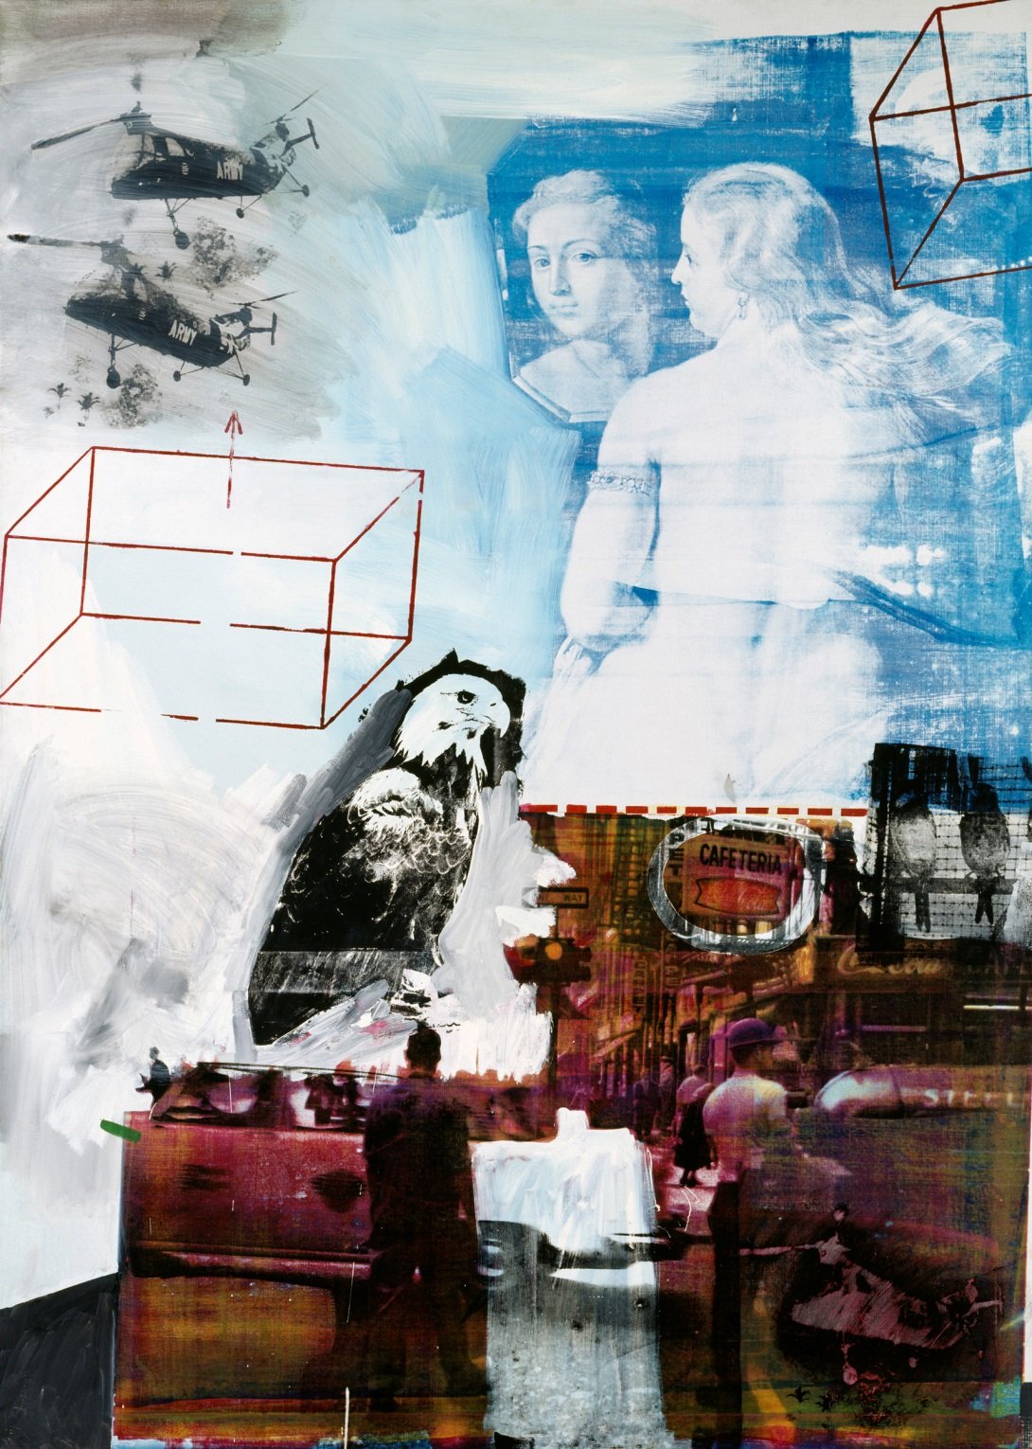
Robert Rauschenberg: Tracer,1963, Oil and silkscreen on canvas

